Slide 1
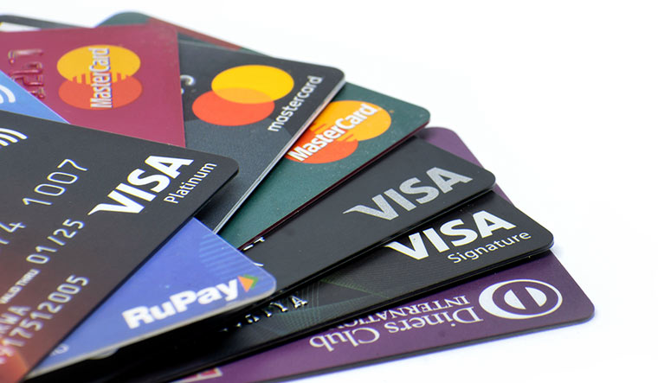


Slide 2
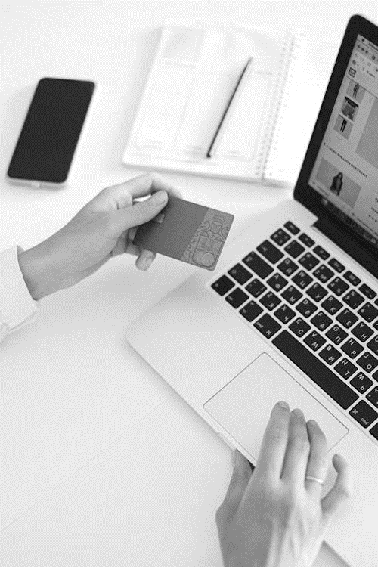
7 in 10
Americans
Sitting on unused cash
back, points or miles
Over $100B

Slide 3

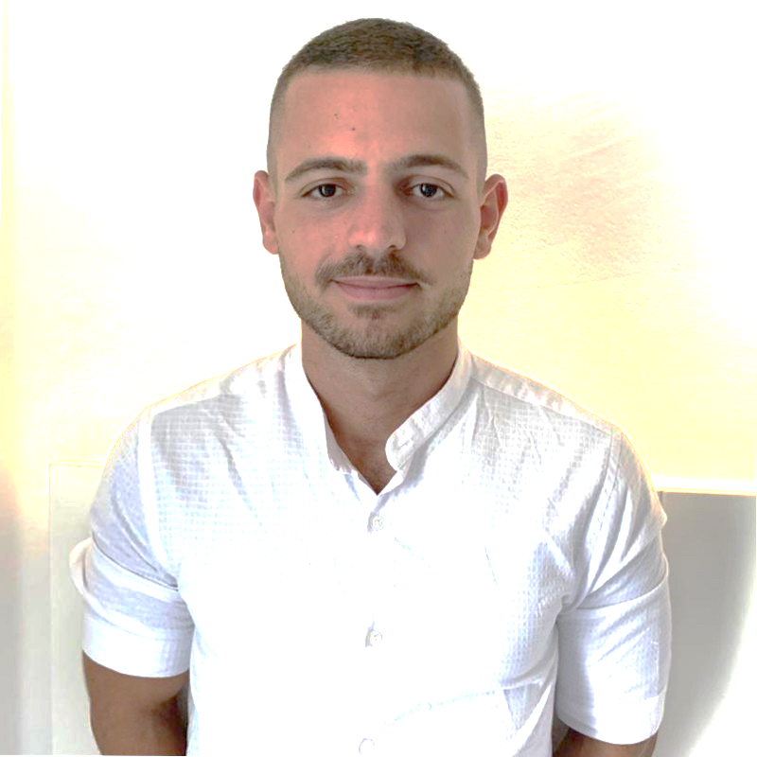
Meet BenefiTrade
Yuval Ofek
Dan Davidovich
Idan Asayag
Omer Ben David
Lior Hassin
Software Developer @ AT&T, 3rd year Computer Science Student
Major Officer in Flotilla 13, 3rd year Computer Science Student
Frontend Developer @ Elta Systems Ltd, 3rd year Computer Science Student.
Software Developer @ IDF, 3rd year Computer Science Student
3rd year Computer Science Student

Slide 4
As of 2022
82%
40%
Of US residents hold at least one credit card (3 in average).
Haven’t cashed in on any rewards in the past year.

Slide 5
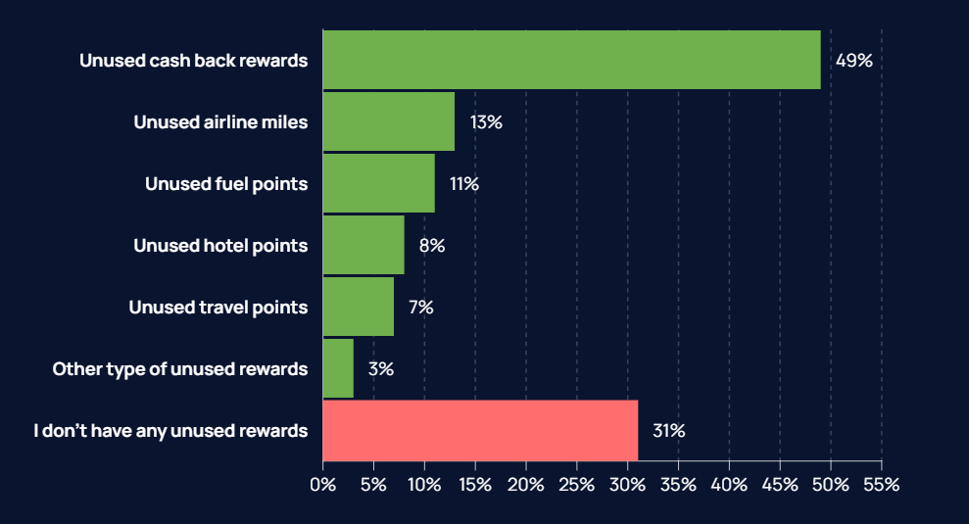
Percentage of credit carholders with unused
rewards, points or miles
Source: LendingTree survey of 1,122 rewards credit cardholders, conducted in July 2022. Respondents could select multiple types of unused rewards.

Slide 6

John
John B
John C
John D
Mileage for a free flight from NYC to Miami

Slide 7



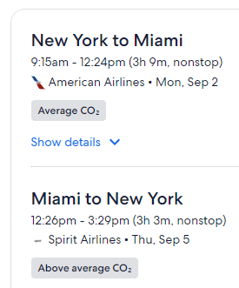
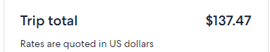
John
Mike’s Family
Mileage for a free flight from NYC to Miami
Search flights from NYC to Miami

Slide 8



John
Mike’s Family
Win
Win

Slide 9
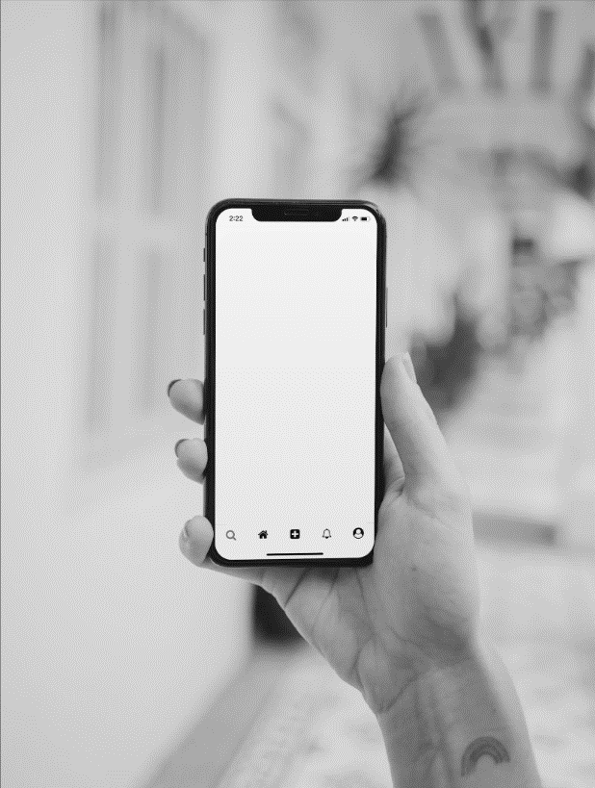

Making your
benefits worth
money

Slide 10
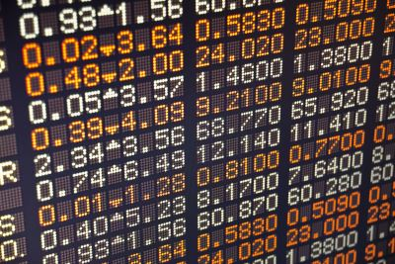
Rewards market
Sellers can list their products they can achieve from unused points, miles, etc.
Buyers can browse available rewards and purchase what best suits their needs in a lower price.
A real-time pricing mechanism adjusts the value of the points and miles based on supply and demand, similar to a stock market. This ensures fair and transparent pricing.
Transactions are secure, with a built-in block-chain system that ensures the transference only occurs once payment is confirmed.

Slide 11
Business model
Sellers
Buyers
Transaction fee of 0.5%
$2 Monthly subscription

Slide 12



Total Available Market (TAM)
69% of American cardholders sitting on unused rewards
200M People
Monthly subscription fee of $2 + 0.5% transaction fee
Over $4.5B/year

Slide 13
Competitors
Brokers
Arrange transactions between a buyer and a seller. Brokers help people to sell their miles and points.
Against of the terms of use
Unsecure

Slide 14
Funding request
$1.8M
Funding will sustain operations for 2 years. Projected outcome: 20K paying customers. Expected revenue: $40,000/month ($480,000/year).

Slide 15
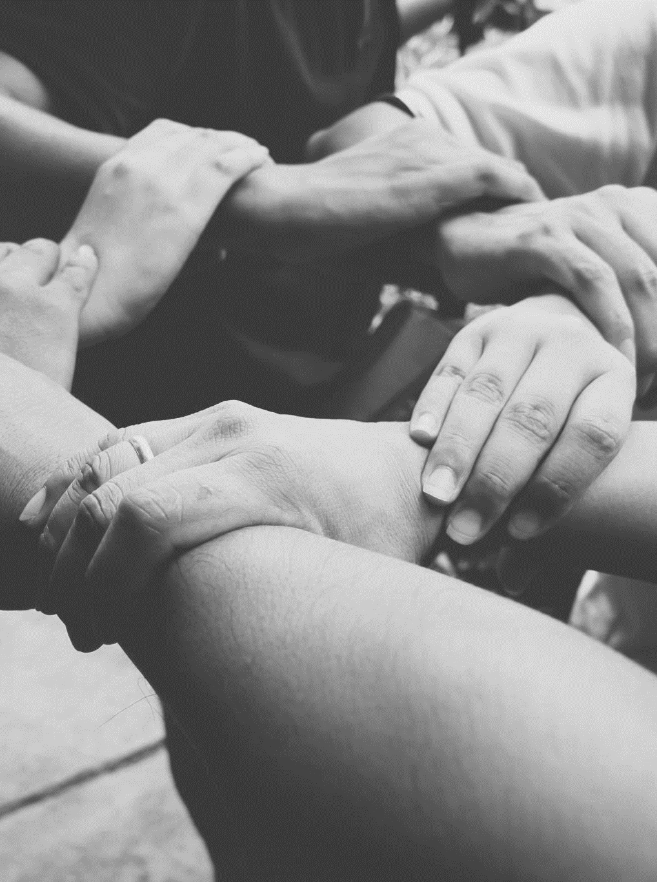
Join us in our mission
to help millions turn
their benefits into
money.

